Slide 1
Food Guide to Lincoln
March 30, 2020
Coursera Applied Data Science Capstone Project

Slide 2
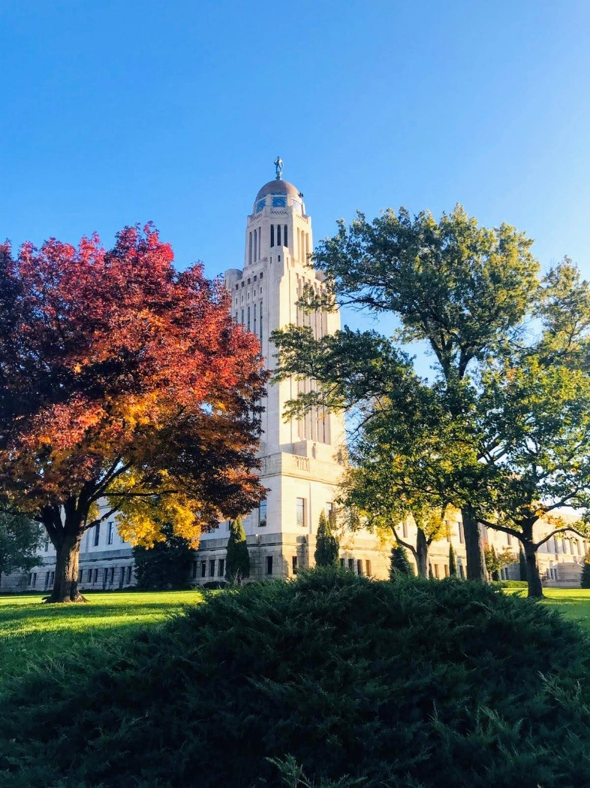
Introduction to Lincoln
Capital city of Nebraska.
Home to one of the members of the Big Ten Conference: the University of Nebraska-Lincoln.
Dubbed one of the most welcoming cities in America.
Increasingly drawing a wide variety of people, including refugees and startup companies.

Slide 3
Project Description
To create a fun and easy food guide to Lincoln using crowd-sourced data from Foursquare.
Those new to the city, or those who have still yet to fully explore the city, may find this guide helpful and informative for their eating and drinking pleasure.

Slide 4
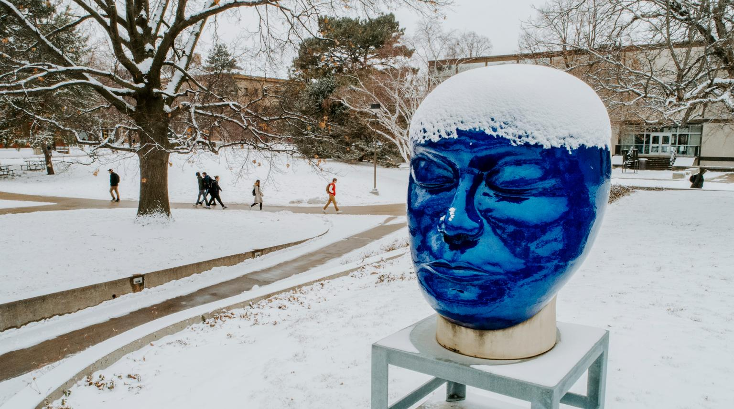
Data
Location data from Foursquare.
The University of Nebraska-Lincoln (UNL) as the central point in Lincoln.
Top venue picks within a 5-mile radius of UNL using the Foursquare API.
Specific focus given to venue categories pertaining to food and beverages.

Slide 5
Methodology
Simple yet meets the needs of creating a food guide for newcomers to Lincoln.
Foursquare API to obtain top venue picks around a given location:
URL constructed by setting appropriate parameters, sending request to Foursquare API, and retrieving search results.
UNL defined as central location with a latitude of 40.820744 and a longitude of -96.700470.
Top venue picks within a 5-mile radius of UNL queried via the API.
Data management to clean and prepare data for further analyses.
Venue results visualized on map.
Additional exploratory analyses conducted to identify top venue picks that pertain to food and beverages.

Slide 6
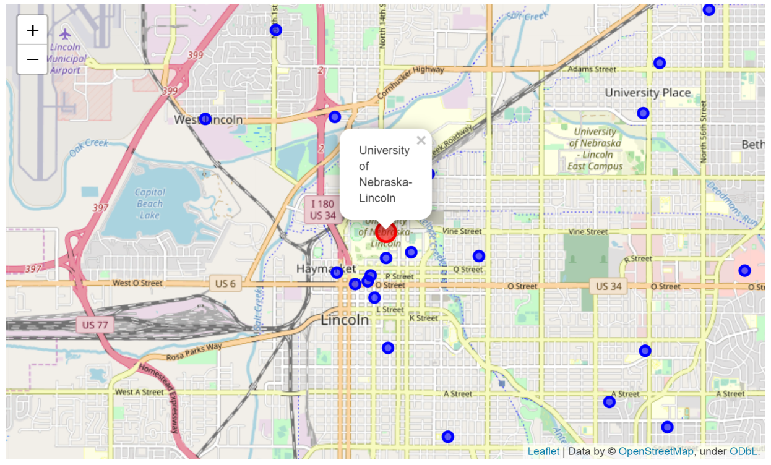
Results
A total of 49 venues obtained.
Categories relevant for food guide are as follows:
bar, pizza place, speakeasy, food, diner, ice cream shop, beer garden, and frozen yogurt shop

Slide 7
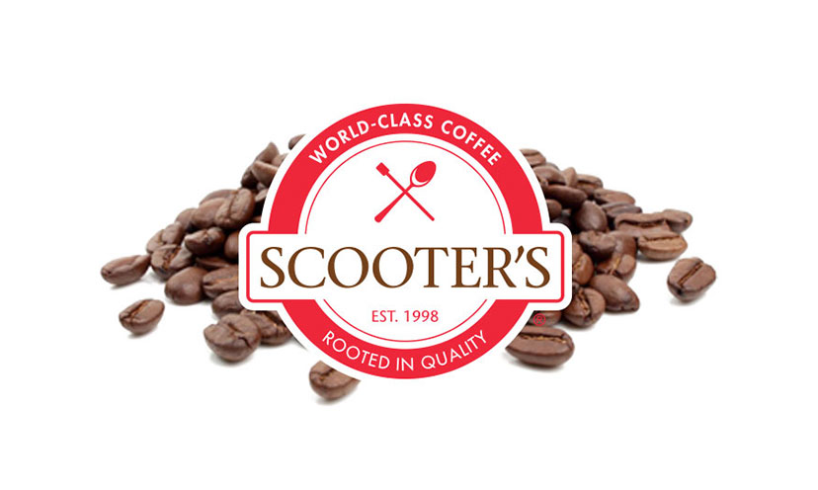
Discussion
Drinks:
The Top Hat
Zee Bungalow
Nebraska Top Hop Competition
Food:
Toppers Pizza
Scooter’s Coffee House
Roof Top Diners
Cherry On Top
Topper Popper

Slide 8
Discussion
Important to note of other crowd-sourced review forums like Yelp and and TripAdvisor.
If Lincolnites do not frequently use Foursquare to review venues, data retrieved from the Foursquare API may not yield the best quality guide to begin with.
Nonetheless, this food guide is still reliable as it is informed by data and not merely the opinion of a single individual.

Slide 9
Conclusion
This project provides a food guide of top venue picks located within a 5-mile radius of the University of Nebraska-Lincoln as informed by Foursquare’s location data.
Those who have recently arrived in the city of Lincoln, particularly new students to the University, may find this guide as:
A good starting point for exploring food and drink options, and
Having reliable spots to meet with people in forming new connections and friendships.

